Slide 1


WoTify A platform to bring Web of Things to your devices Second W3C Workshop on the Web of Things 3-5 June 2019, Munich, Germany Ege Korkan, Technical University Munich Hassib Belhaj Hassine, Technical University Munich Verena Eileen Schlott, Ludwig Maximilian University of Munich Sebastian Käbisch, Siemens AG Sebastian Steinhorst, Technical University Munich

Slide 2
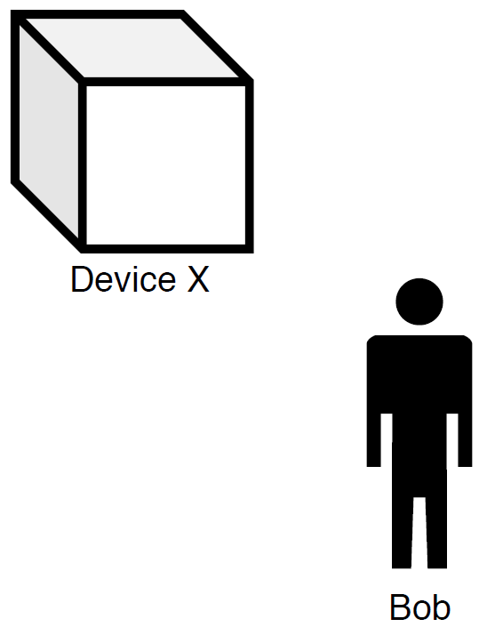
A WoTify Story
Notes:
Bob who is a WoT developer, wants to make his device a WoT device

Slide 3
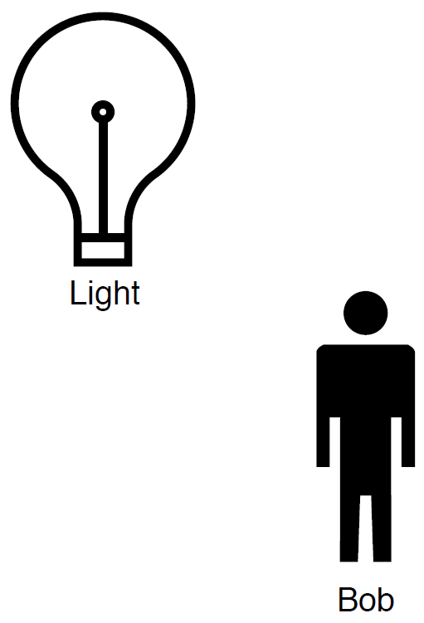
A WoTify Story

Slide 4
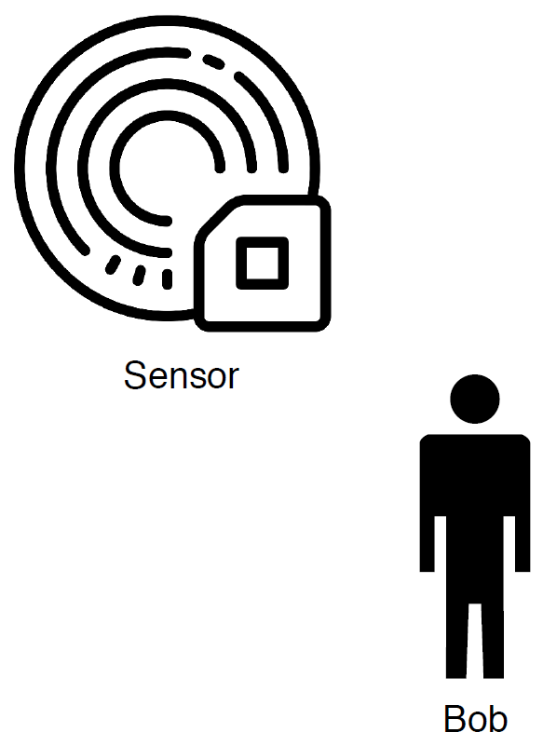
A WoTify Story

Slide 5
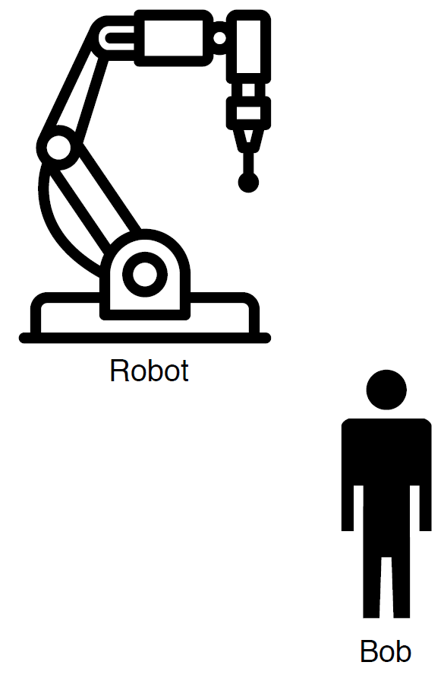
A WoTify Story

Slide 6

A WoTify Story
Notes:
To be a WoT device, it should produce a TD
This can be done by anyone, companies can also provide a TD for their devices on WoTify

Slide 7
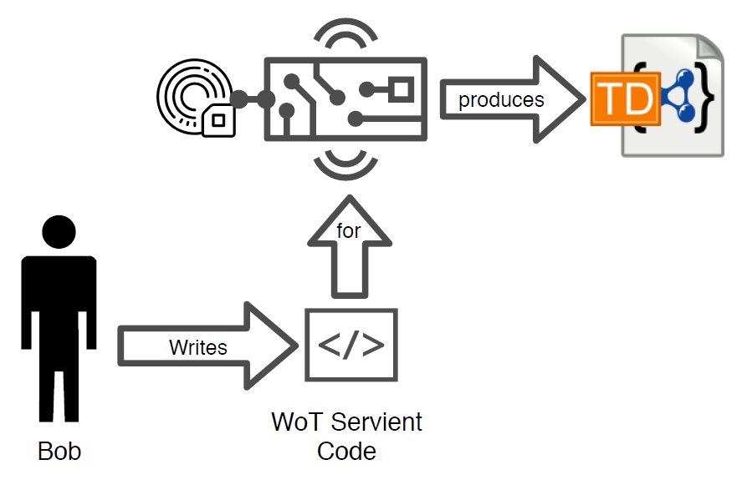
A WoTify Story: Contributing to WoTify

Slide 8

A WoTify Story

Slide 9
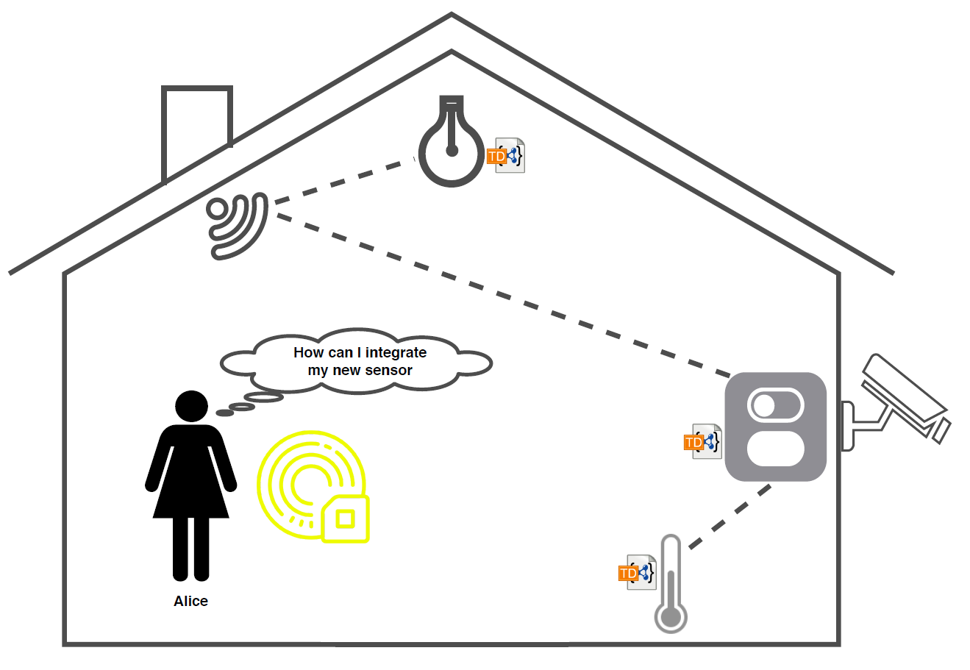
A WoTify Story: WoTifying a Sensor

Slide 10
A WoTify Story: WoTifying a Sensor

Slide 11
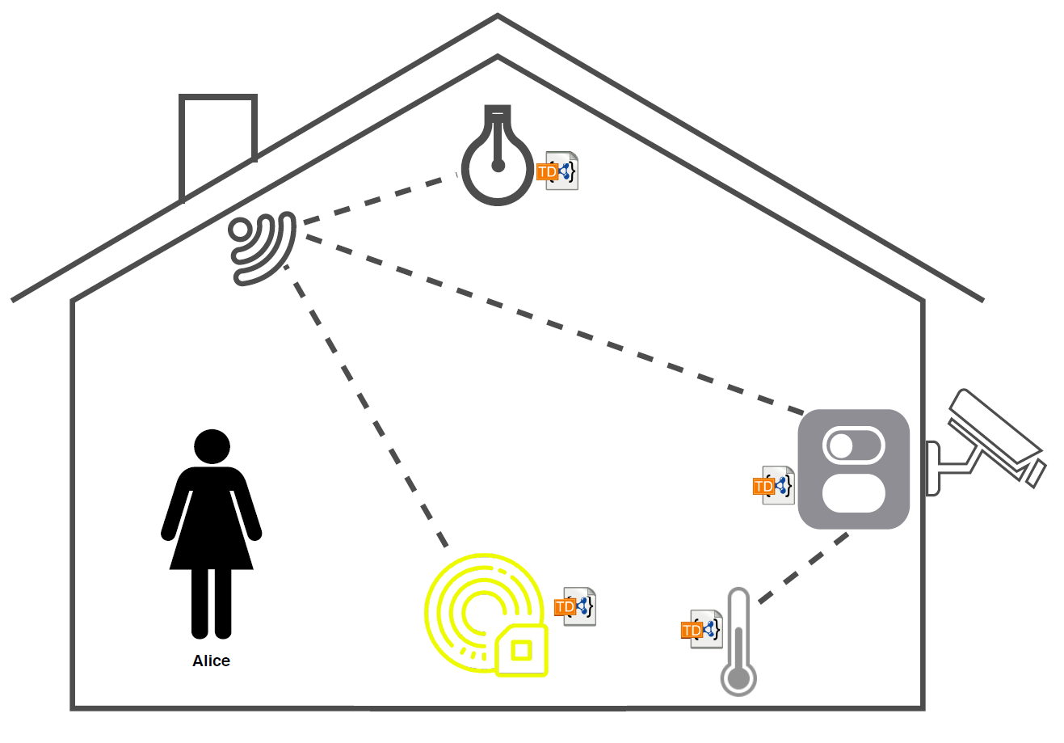
A WoTify Story: WoTifying a Sensor

Slide 12
WoTify is
A platform from the WoT community for the WoT community, that allows:
to show Web of Things implementations to everyone
to contribute to the Web of Things
to make different devices Web of Things enabled
Available at wotify.org

Slide 13
Looking forward to all of your contributions!
THANK YOU

